Slide 1
Machine Learning
Leveraging cloud technologies to change the economics of making smart apps

Slide 2
The Challenge
Demonstrate the application of machine learning to make a live app smarter
Show how cloud technologies have profoundly affected the ability to apply ML in the real world
Our app will start with a base of MNIST as a training set...
But then we will train our app over time by providing it feedback about where it went wrong so it gets smarter over time and more personalized for a given user
Demonstrate how cloud technologies are scaling up the value chain of ML by decoupling learning & modeling from developers calling prediction APIs “as a service”

Slide 3
Bill of Materials
Algorithms | K-Means, MXNet, TensorFlow, XGBoost
Coding | Python, Pandas, Flask, HTML/CSS/Bootstrap, JavaScript, Amazon Sagemaker SDK
Platforms | DynamoDB (instead of Mongo), Amazon AWS, Tableau, Docker Containers

Slide 4
Cloud Technology Stack
Our team chose Amazon’s SageMaker service which provided the following benefits:
Python SDKs to cut down on lines of code for training and inferences
Ability to provision and terminate compute and storage resources on the fly, paying only for what we used
Hosted Jupyter notebooks with ML libraries pre-installed
Compute containers pre-loaded with ML algorithms ready to be trained

Slide 5









ML Enabled App Architecture in AWS
Features:
Serverless app front end – no servers to manage, automatic scale up and down
Large training clusters only used temporarily to train model – no paying for standing training clusters
Pre-configured containers with ML libraries and algorithms pre-loaded
Training data and trained model data stored in inexpensive, web-accessible object stores
Hosted Jupyter notebooks with pre-installed libraries – no more ‘pip install’
CLI or GUI access for all steps
Seamless integration between data scientists and smart app developers
Retrain Model with Actual Results
Temporary cluster to train the model
Actual Results
Model Deployment
Pre-Configured ML Containers
Transient Training Cluster
Flask on EC2
HTML & Python
Smart App
Trained Model
Predictions
Training Data
Data Scientist
Jupyter Notebook on EC2
Trained Model
MXNet & Tensorflow Inference Endpoints
Libraries:
Python
AWS Sagemaker
ML Models
S3 Object Store
Web API Accessible Mass Storage
AWS Cloud

Slide 6
Apps that get smarter over time
Determine Problem
Smart application factories can rapidly scale up capabilities by decoupling the ML processes from app development
App developers can call endpoints provided by the data science function for predictions without knowing anything about machine learning or analytics
In this model, the intelligence of the app is provided “as a service” through an API available to developers for predictions
Data scientists, in turn, can use actual data from the live app to retrain and improve the inferences provided by their ML algorithms
The apps ”get smarter” over time
Data Scientist
Research & Narrow
Developer
Source Data
Iterate & Test
Narrow & Deploy
Continuous Learning
Smart App

Slide 7
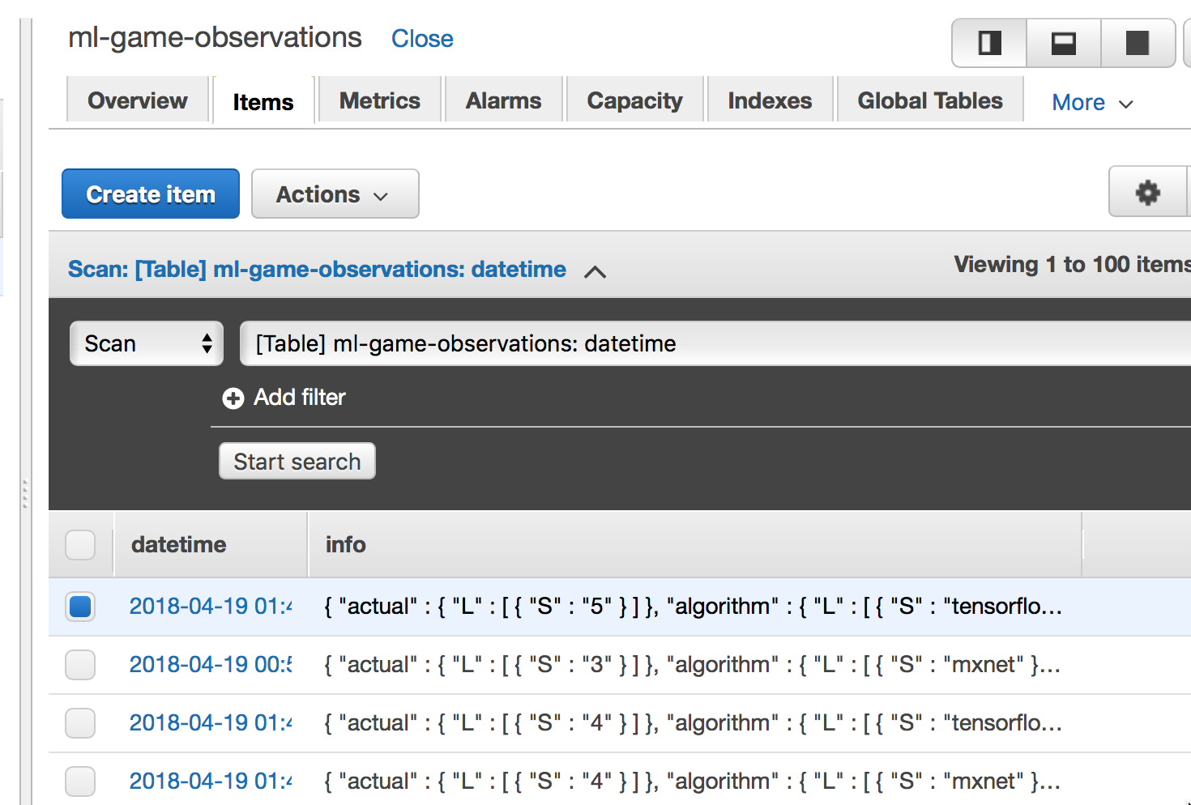
Getting Smarter Over Time
dynamodb = boto3.resource('dynamodb', region_name='us-west-2', endpoint_url="https://dynamodb.us-west-2.amazonaws.com")
table = dynamodb.Table('ml-game-observations’)
pe = "info"
response = table.scan(
ProjectionExpression=pe
)
import pandas as pd
dfTrain = pd.DataFrame(columns=['label', 'image’])
dfTrain.to_csv('train.csv', header=False, index=False)
Extract Data
Retrain Model
Deploy to Endpoints
Application Persistence Layer

Slide 8
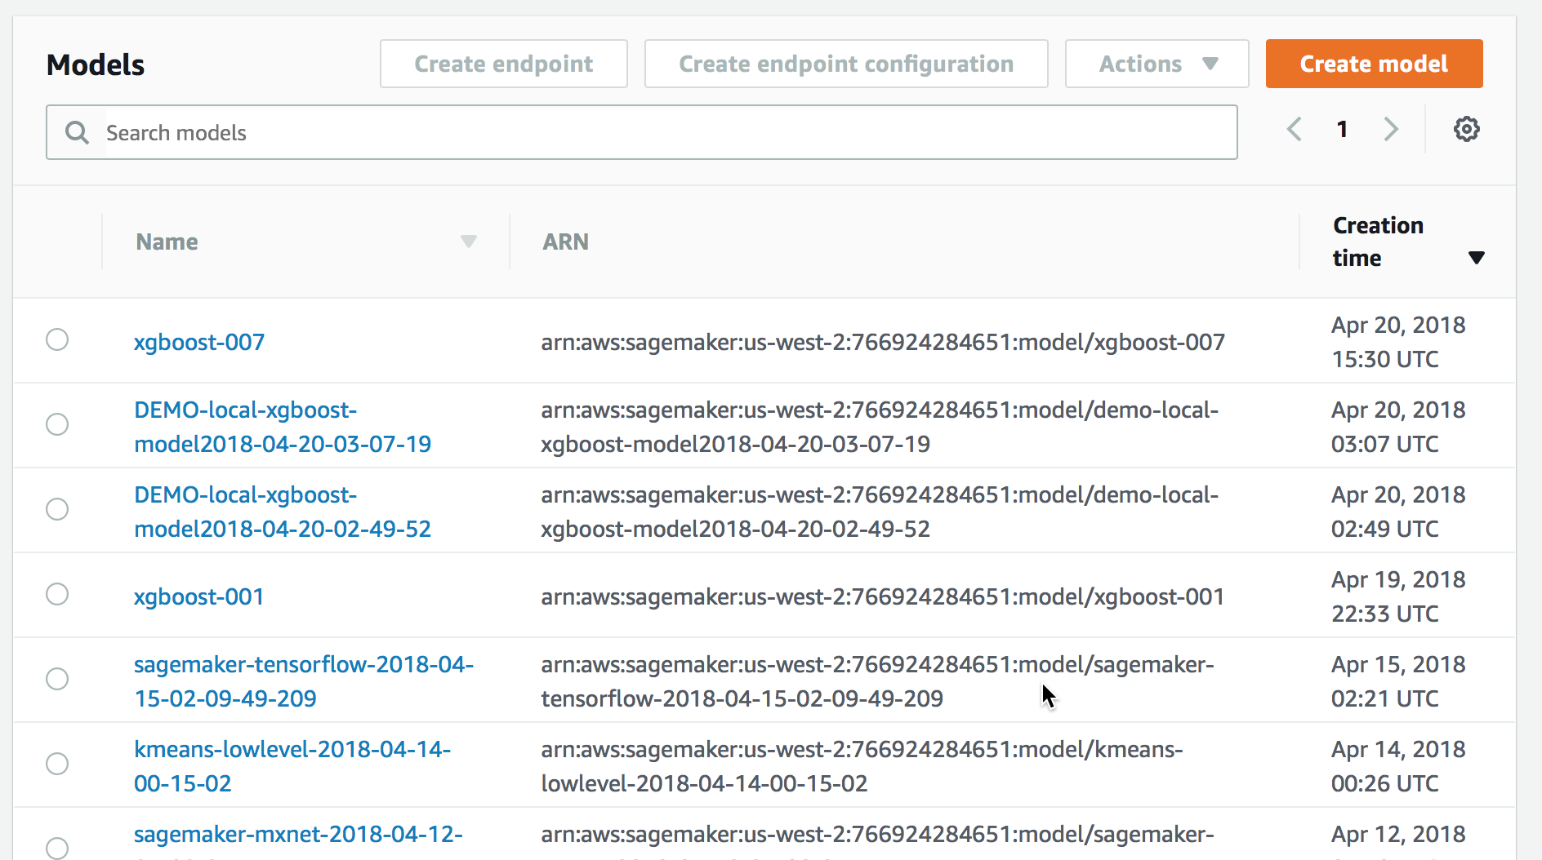
SageMaker Manages Your Library of Trained Models

Slide 9
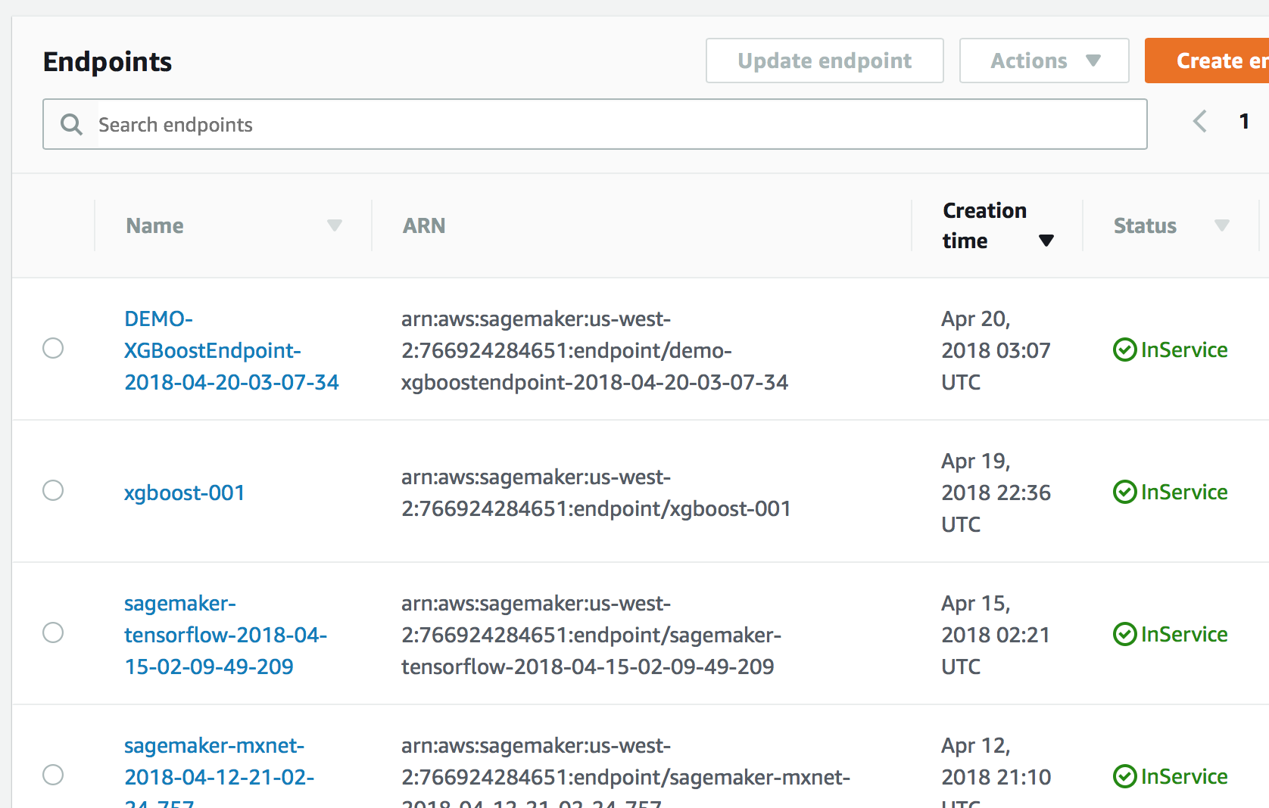
SageMaker Also Hosts Inference Endpoints for Developers to Call

Slide 10
Noteworthy Code Snippets
Cloud makes it easier…
Training the model with compute-optimized EC2 instances: Data Scientist
Using the Sagemaker SDK to make calls to the inference endpoint easier: Developer
from sagemaker.tensorflow import TensorFlow
mnist_estimator = TensorFlow(entry_point='mnist.py',
role=role,
training_steps=1000,
evaluation_steps=100,
train_instance_count=2,
train_instance_type='ml.c4.xlarge')
mnist_estimator.fit(inputs)
@app.route('/tensor')
def tensor():
mynumber = request.args.getlist('image')
predictor = TensorFlowPredictor('sagemaker- tensorflow-2018-04-15-02-09-49-209')
mynumberarray = ast.literal_eval(mynumber[0])
response = predictor.predict(mynumberarray)
prediction = response['outputs']['classes']['int64Val'][0]
answer= ("Most likely answer: {}".format(prediction))
return(answer)
Deploying the trained model on an inference endpoint
mnist_predictor = mnist_estimator.deploy(initial_instance_count=1,
instance_type='ml.m4.xlarge')

Slide 11
Key Lessons Learned
Economics | Cloud has revolutionized the economics of ML & AI. This is why so many things we buy these days are “smart”. The cost has come down to integrate ML into everyday things. Our team was able to train an algorithm with 70 thousand images in six minutes for pennies
Algorithms | Different algorithms produce varying results for a particular application. Experimentation and trial and error is required
Apps | ML in a vacuum is not nearly as useful as connecting ML to an app in a continuous feedback loop to make the model smarter over time

Slide 12
Conclusions
Cloud economics have made ML functionality accessible to the masses
Small companies with few capital resources can disrupt entire industries that make “dumb” things
Combined with cloud-based IoT, Intelligence is being integrated into everyday things that get better over time
ML is getting easier through publication of SDKs which abstract complexity
Developers don’t need to know ML to make intelligent apps, Data Scientists can make their work available directly to apps through endpoints APIs

Slide 13
AWS Economics
Model training:
Two c4.xlarge instances @ $.199 per hour * 6 minutes = 4 cents to train model with 70,000 records
8 CPU & 16 GB RAM
Inference Endpoint Hosting:
One m4.xlarge instance @ $.2 per running hour, or $1,013 for one year of sustained 24 x 7 usage
4 CPU & 16 GB RAM
DynamoDB for app persistence:
Free tier: < 25 GB of storage and < 25 read/writes per second
Infrastructure scales to meet demand
Jupyter Notebook Hosting:
One T2.medium @ $.0464 per running hour or $235 for one year of sustained 24 x 7 usage
2 CPU & 4 GB RAM
Sagemaker SDKs = Free
Pre-configured algorithm containers = Free
Software licenses = Free

Slide 14
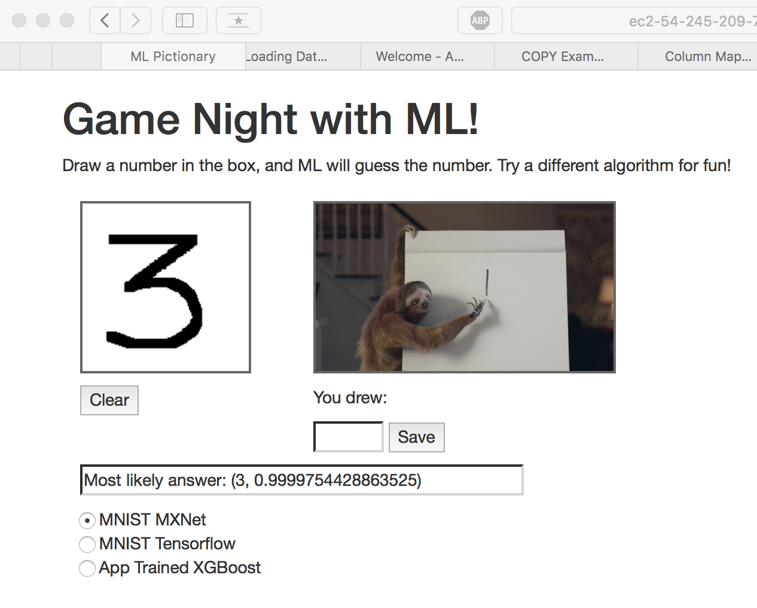
Smart App

Slide 15
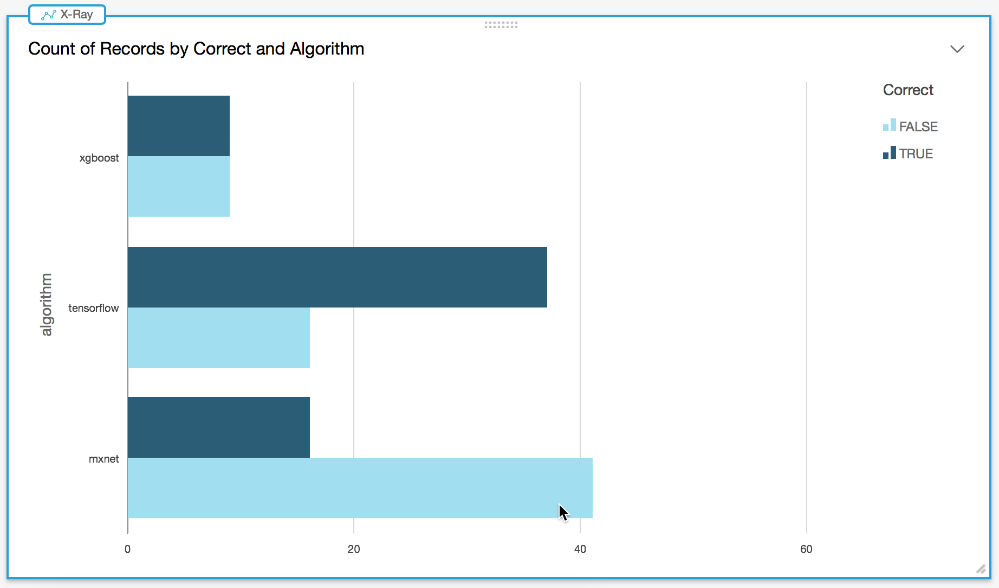
Tensorflow with MNIST was Most Accurate

Slide 16
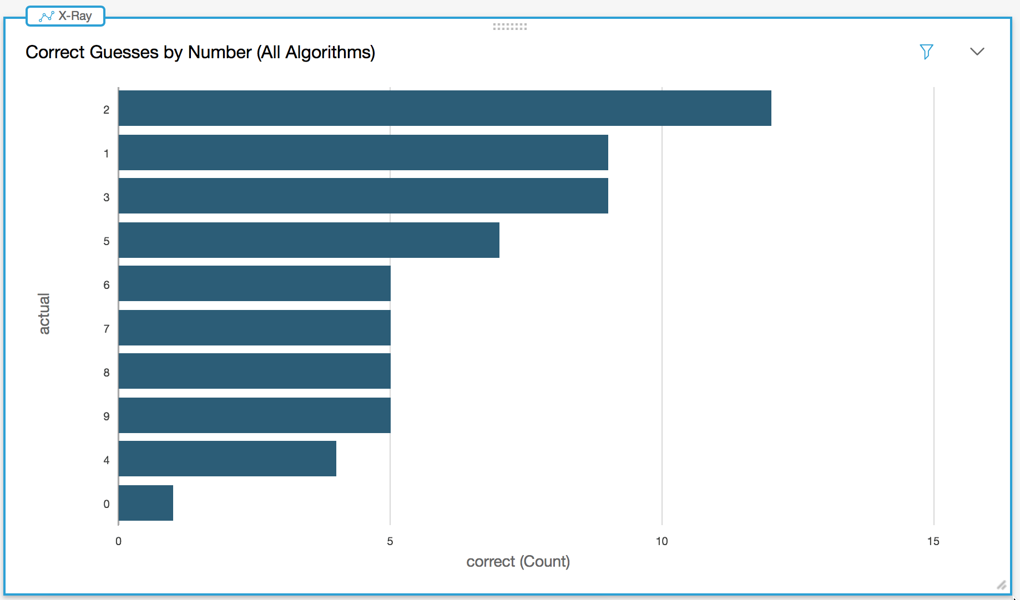
‘2’ Was the most correctly guessed, while ‘0’ was least correctly guessed

